Slide 1
Processes
Program vs Process
Process Concept
Process Scheduling
Operations on Processes
Threads
Cooperating Processes
Interprocess Communication
Communication in Client-Server Systems

Slide 2
Program Generation and Execution
Editing in certain programming Language
Compilation (converting high level code to executable code)
    Usually a re-locatable code (starting from zero address) in a file on disk
Linking (Making a single module from main module and other sub procedures)
Types of generated codes
  Absolute code (loadable at some specific address)
  Re-locatable code (loadable at any address)
  Re-entrant code (pure code, no data dependency)
Loading and Relocation
  Compile time Relocation (address binding at compilation time)
  Static Relocation
    Address binding at loading time (same logical and physical addresses)
  Dynamic relocation at execution time (needs H/W support)
    Address binding at run time (different logical and physical addresses)

Slide 3
Process and its Management
Program is a passive entity, process is an active entity.
A process is a program in execution. It is a unit of work within the system.
Process needs resources (allocated at beginning or during execution) to accomplish its task
    CPU, memory, I/O, files
    Initialization data
Process termination requires reclaiming of all reusable resources
Usually process has one program counter specifying location of next instruction to execute (Process executes instructions sequentially, one at a time, until completion)
Multi-stream (threaded) process has one program counter per thread
Typically system has many processes, some user, some operating system utilities running concurrently on one or more CPUs
    Issues: Mutual exclusion, Concurrency and synchronization issues arise by multiplexing the CPUs among processes / threads

Slide 4

Process in Memory
Working Storage Area
(Dynamic Memory Allocation and Stack)
Program code and data Area

Slide 5
Process Concept
Process
code
Data
PCB
Resources
stack
Terms task, job and process are used almost interchangeably
Process – “a program in execution”. Execution normally progresses in sequential fashion depending upon instructions. “Animated spirit of program code (text)”
A process includes:
  program counter and other registers
  stack
  Work and data space, along with other resources, files etc.
  System data-structure for process: process descriptor or Process Control Block (PCB), to hold info about state of a process. PCBs of all processes in a system are maintained in a doubly linked queue
An operating system executes a variety of programs:
  Batch system – Collection of jobs
  User programs or tasks
  Interactive Tasks

Slide 6
Process Concept
Terms Job, Task and Process are used almost interchangeably
Process – a program in execution. Execution progresses in a sequential fashion depending upon instructions of the program
A process includes:
  program counter (Instruction Pointer)
  stack
  Work and data space, along with other resources
  System data-structures for process (PCB: Process Control Block )
An operating system executes a variety of programs:
  Batch system – Collection of jobs, mostly running independently in background. (using JCL: Job Control Language)
  User programs or tasks
  Interactive Tasks

Slide 7
Batch (collection of) Jobs Execution
. . .
Job 1
Job 2
Job 3
Job 4
Job N
Submission of jobs one after the other for execution on a machine in certain computer center, computer being used as a collective resource.
A number of jobs may be available in a queue that are executed First In First Out (FIFO) fashion
Job Control Language (JCL) is used to separate various activities with in a batch queue.
A single job is set for execution at a time
Jobs are submitted on first come first serve basis

Slide 8
Batch and Background Execution (2 jobs)
Batch jobs are normally executed in foreground in central computing environments
    Example of JCL
        // job sort --- Ikram, first semester --- Physics Department
        // for
        Program code in Fortran
        /*
        // link
        //exec
        Data
        /*
        /&
Foreground and Background Execution (two concurrent processes)
  In order to make better utilization of resources, Batch jobs are executed in fore ground, whereas, some lengthy job is set for execution in the background, at a low priority.

Slide 9

Memory Layout for Multiprogramming System
Address

Slide 10
Schedulers
Long-term scheduler (or job scheduler) – selects which jobs should be brought into the ready queue for execution
  Automatic (out of batch of jobs queue)
  Manual (out of jobs that need execution)
  Invoked (by user) very infrequently (seconds, minutes) ⇒ (may be slow)
  The long-term scheduler controls the degree of multiprogramming i.e. No. of processes executing in RAM
Short-term scheduler (or CPU scheduler) – selects which (ready to run) process should be executed next by allocating CPU to it. (scheduled by OS)
  The timer Interrupt (at regular intervals) enables the operating system to review its scheduling policy
  Invoked very frequently by OS (milliseconds) ⇒ (must be fast)

Slide 11
Categorization of processes (Behavior dependent)
Processes can be categorized as either:
  I/O-bound process – spends more time doing I/O than computations, many short CPU bursts
    CPU mostly Free,
    I/O devices mostly busy
  CPU-bound process – spends more time doing computations; few but very long CPU bursts
    CPU mostly busy,
    I/O devices under-utilized

Slide 12
Process States
A process changes its states as it proceeds in a machine
  new: The process is being created (long term scheduling)
  running: Processor has been assigned, Instructions are being executed, holding CPU.
  waiting: The process is waiting for some I/O or some event to occur
  ready: The process is ready to run and waiting to be assigned processor for its execution
  terminated: The process has finished execution

Slide 13
Jobs/Process Scheduling Queues
Job queue – set of all Jobs in Batch
Job Executing – Any executing Job to which CPU is assigned currently
Ready queue – set of all processes residing in main memory, ready for execution, got everything except CPU
Device queues – set of waiting or Blocked processes waiting for an I/O Completion on different particular devices. For each device there is independent queue of waiting jobs.

Slide 14

Diagram of Process States
Short Term Dispatch Scheduler
(Selection among jobs in ready queue)

Slide 15
Migration of processes among different states
Processes can migrate among various states or queues depending upon various events
  New  Ready
    user’s initiated, long term scheduler
  Ready  Running
    short term or CPU scheduling policy
  Running  Ready
    Time up timer interrupt, short term or CPU scheduling policy
  Running  Termination
    Execution of exit instruction by the running process
  Running  waiting
    Execution of some instruction for I/O or wait for certain event
  Waiting  Ready
    I/O Completion or occurrence of the required event

Slide 16

Representation of Process Scheduling
New Job
Exit

Slide 17
Scheduling policies
Long term scheduling (Jobs to execute)
  Shortest job first
  Priority job first
Short term scheduling policies (Next Job to execute)
  Priority job first
  Round robin scheduling
  Multiple feedback queues
Medium term scheduling (Suspend/Resume Jobs)
  Suspend: temporarily suspend, No competition for CPU allocation
  Resume: resume any suspended job, compete for CPU allocation

Slide 18

Medium Term Scheduling
Partially executed processes are stopped temporarily from competing for the resources and they can resume execution later.
The Suspend - Resume commands provided by the Operating System (OS), can be used accordingly.
They can even be swapped-out to secondary storage (upon demand for RAM) by OS or manually, to accommodate some other process to execute. Later these suspended processes are swapped-in to RAM and can resume their processing, from the point where they were suspended.

Slide 19
Medium Term Scheduling
A process is suspended by OS or user. It may even be swapped out onto disk, if there is a requirement of RAM
Resume
Suspended Ready
Ready
Suspend
Timer Interrupt & S.T. Scheduling
suspend
I.O done
Executing
I/O Complete
I.O done
Exit
I/O request
Suspended Waiting
Waiting for I/O
suspend
Resume
Suspended process may be resumed and swapped into RAM for execution using Resume directive.

Slide 20
Context Switching
(The Processor switches its context from one process to an other)
Process Switching (context switching of CPU) takes place
    whenever processes change their state.
    The timer (Time Quantum up) interrupts or some other interrupt occurs and enables the operating system to review its scheduling policy.
    Any job which has requested an I/O
    Any process which has executed an exit instruction
When CPU switches to another process,
    The system must save the state of the current process in its Process Control Block (PCB) and load the saved state of the next process from an other PCB in ready queue.
Context-switch time is an overhead
    The system does no useful work while switching.
    Context-switch time depends on software/hardware support, it should be least.

Slide 21

CPU Switching From Process P0 to P1 and to P0 again
Context-switching
Context-switching

Slide 22
Process Control Block (PCB)
Information associated with each process
Process state, id-no.
CPU registers including Program counter
CPU scheduling information
Memory-management information
Accounting information
I/O status information

Slide 23

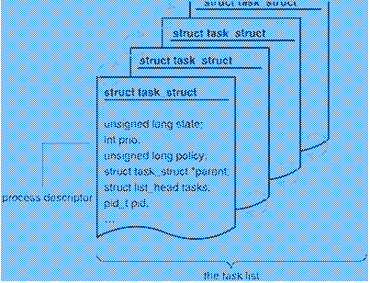
Process Control Block (PCB or process descriptor)
PCBs are chained in different queues according to their state.
PCB
PCB
PCB
PCB
In Linux, Process descriptors are stored in dynamic memory rather than in the memory area permanently assigned to the kernel. Several functions and macros implement the primitives to manage doubly linked list in Linux.

Slide 24
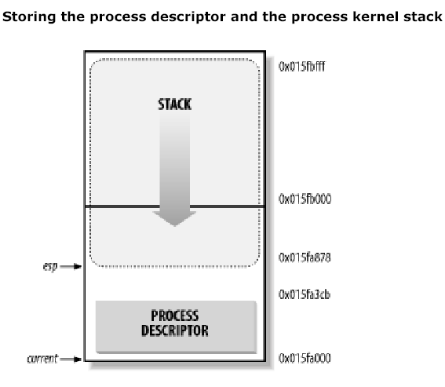
Linux Process Descriptor (8 KB )
A process in Kernel Mode accesses a stack contained in the kernel data segment, which is different from the stack used by the process in User Mode. Since kernel control paths make little use of the stack, only a few thousand bytes of kernel stack are required. Therefore, 8 KB is ample space for the stack and the process descriptor. The two data structures are stored in the 2-page (of 8 KB = 2¹³ bytes) memory area. The process descriptor resides at the beginning and the stack grows downward. The process descriptor is less than 1,000 bytes long, the kernel stack can expand up to 7,220 bytes.
Stack: 7220 Bytes
PCB: 972 Bytes

Slide 25

Ready Queue (Ready for execution) And
Various Device Queues (waiting for I/O completion)
PCBs of different processes are linked into different queues

Slide 26
Process Creation
Parent process creates children processes, which, in turn may create other processes, forming a tree of processes
Resource sharing possibilities
  Parent and children share all resources
  Children share subset of parent’s resources
  Parent and child share no resources
Execution
  Parent and children execute concurrently
  Parent waits until children terminate

Slide 27
Process Creation (Cont.)
Address space
  Child may be duplicate of parent
  Child has its own program executing in a new address space.
UNIX examples
  Fork() system call creates a new process (duplicate)
  exec system call is used after a fork() to replace the process’ memory space with a new program
Fork
  creates a new PCB
  Creates a new child process by assigning the same address space of the parent (thus parent duplicates itself)
  Fork returns twice once to the child, and then to parent, with different return values (PID number)

Slide 28
Fork()
  Parent and child both run the same code
    Distinguish parent from child by return PID value from fork, returns 0 to the child process and child’s PID to the parent process. Both parent and child can continue forking. fork() returns first to the child, then to parent
  Start with same state, but each has private copy Including shared output file descriptor
  Relative ordering of their print statements (execution) is undefined (due to arbitrary scheduling decisions)
void main()
{
pid_t pid = fork();
printf(“ Child’s PID: %d\n", pid);
if (pid == 0) {
printf(“ Child Executing\n", );
} else {
printf(“ Parent Executing\n");
}
printf(“ Bye from process with PID: %d \n", getpid() );
}

Slide 29
Running entirely a new ‘COPY’ program on UNIX
The exec() family of function calls directive is used to create a new address space and load a new program.
exec() is invoked just after fork()
The directive int execl (char *path, char *arg0, char *arg1, …, 0)
  loads and runs executable code at path with arguments arg0, arg1, …
    path is the complete path of an executable binary
    arg0 becomes the name of the child process
      typically arg0 is either identical to path, or else it contains only the executable filename from path
    list of args is terminated by a null character (char * 0) argument
  returns -1 if error
Following parent, forks a child program that copies “foo” file as “bar”
main() {
if (fork() == 0) {
execl ("/usr/bin/cp", "cp", "foo", "bar", 0);
}
wait(NULL); //wait for child to exit
printf ("copy completed\n");
exit();
}

Slide 30
Program Forking a DIR Process
int main()
{
Pid_t pid;
/* fork another process */
pid = fork();
if (pid < 0) { /* error occurred */
fprintf(stderr, "Fork Failed");
exit(-1);
}
else if (pid == 0) { // execute ‘ls’ (DIR) as a child process
execlp("/bin/ls", "ls", NULL);
}
else { /* parent process */
/* parent will wait for the child to complete */
wait (NULL);
printf ("Child Completes");
exit(0);
}
}

Slide 31

Process Creation and waiting for its completion
Fork() creates a new PCB and a new child process by allocating the same address space (thereby the same code) for child as that of the parent process.
The exec() loads a new executable program from the file system on disk, to behave as a child. It uses the same PCB of the child as PCB of new loaded process.
The parent can wait by using a wait() directive, for a successful or an erroneous exiting by the child, depending upon the value supplied in exit().
When a process exits, it is placed in zombie state, used to represent terminated processes until the parent calls wait().
The child whose parent exits earlier than itself, is adopted by the init process.

Slide 32

A tree of processes on a typical Solaris

Slide 33
Process Termination
Process executes last statement and asks the operating system to delete it (exit)
  Output data from child to parent (via wait)
  Process’ resources are deallocated by operating system
Parent may terminate execution of children processes (abort) on:
  Child has exceeded allocated resources
  Task assigned to child is no longer required
  If parent is exiting, since some operating system do not allow child to continue if its parent terminates
      All children terminated - cascading termination

Slide 34
Threads: Independent streams of execution within a single process.
Users or Super Compilers can generate Threads that support more than one parallel streams of execution.
No race condition should be in parallel streams of execution (The threads should be orthogonal)
Threads are light weight processes (Register set and stack space)
Remarks
  Least context switching overhead
  Threads can generate other threads, consuming Task’s resources
  Resources of the task are sharable by all its threads
  Concurrency control problems- Critical sections, locks, …
  System level threads … handling by system calls (kernel)
  User level threads … handling by user libraries (not kernel)

Slide 35
Threads
Scheduling
  System or kernel level threads … Scheduling by the Operating System
  User level threads … Scheduling by user libraries (threads within a process for OS) e.g. p-threads
Benefits of multiple threads
  Increased responsiveness
  Better resource utilization by Resource sharing within a process
  Closeness to reality (parallel activities in real world)
  Ability to take advantage of multi-processors,
  Better throughput even in case of uni-processor system

Slide 36
Concurrent Processes
Independent processes cannot affect or be affected by the execution of another process
Cooperating processes can affect or be affected by the execution of another process
Advantages of cooperating processes
  Information sharing
  Computational speed-up
  Modularity (Easy development and maintenance)
  Easy development of Industrial Process Control
  Convenience

Slide 37
Shared Memory
The parent and child can share the same memory
    ref=shmget (size) Linux directive is used to allocate dynamic memory of the required size
    ptr=shmat (ref) directive returns the starting address of the new region, within the process address space.
    ref=shmdt (ref) directive detaches shared memory from the process address space.
Child inherits shared memory
void main()
{
ref=shmget (size) // get shared memory
mptr= shmat (ref); // attach shared memory before forking a child
pid_t pid = fork();
if (pid == 0) {
printf(“ Child Executing\n", );
} else {
printf(“ Parent Executing\n");
}
}

Slide 38
Producer-Consumer Problem
Paradigm for cooperating processes, producer process produces information that is consumed by a consumer process
  unbounded-buffer places no practical limit on the size of the buffer
  bounded-buffer assumes that there is a fixed buffer size
Producer
Shared Buffer
Consumer

Slide 39
Bounded-Buffer – Shared-Memory Solution
in
out
Producer
Consumer
Shared data
      #define BUFFER_SIZE 10
      Typedef struct {
      . . .
      } item;
      item buffer[BUFFER_SIZE];
      int in = 0;
      int out = 0;
Solution is correct, but can only use BUFFER_SIZE-1 elements

Slide 40
Bounded-Buffer – Insert() Method
(The buffer is circular, “in” pointer is for insertion of item)
/* Limited buffer of size = BUFFER SIZE */
/* in and out buffer pointers are initialized to zero */
while (true) {
/* Produce an item , wait to buffer it */
in = (in + 1) % BUFFER SIZE ; /* try next */
while ((in % BUFFER SIZE) == out)
; /* wait, do nothing -- no free buffers */
buffer [in] = item;
}

Slide 41
Bounded Buffer – Remove() Method
(The buffer is circular, “out” pointer is for removal of item)
while (true) {
while (in == out)
; // do nothing -- nothing to consume
// remove an item from the buffer
item = buffer[out];
out = (out + 1) % BUFFER SIZE;
return item;
}

Slide 42

Inter Process Communications Models
These models are limited to single machine
a): Using Kernel area for communication
b): Using Shared Memory for communication

Slide 43
Inter-process Communication (IPC)
Mechanism for processes to communicate and to synchronize their actions (Limited to single machine)
  Shared Memory
  Shared Event Flags
Message system – processes communicate with each other without resorting to shared variables IPC facility provides two operations:
    send(message) – message size fixed or variable
    receive(message)
Message system across Processes / Systems needs naming of systems and processes: If P and Q wish to communicate, they need to
  establish a communication link between them
  exchange messages via send/receive directives
    Send (P, message_data) // send data to process P
    Receive (Q, message_data) // receive data from process Q
Implementation of communication link associated with processes that know each other’s identity to communicate. The link can be
  physical (e.g., shared memory, hardware bus)
  logical (e.g., logical properties)

Slide 44
Implementation Questions
How are links established?
Can a link be associated with more than two processes?
How many links can there be between every pair of communicating processes?
What is the capacity of a link?
Is the size of a message that the link can accommodate fixed or variable?
Is a link unidirectional or bi-directional?

Slide 45
Direct Communication
Pipes
Messages: Processes must name each other explicitly:
  send (P, message) – send a message to process P
  receive(Q, message) – receive a message from process Q
Properties of communication link
  Links are established automatically
  A link is associated with exactly one pair of communicating processes
    Between each pair there exists exactly one link
  The link may be unidirectional, but is usually bi-directional

Slide 46
Indirect Communication
Messages are directed and received from mailboxes (unique ID) or ports
  Each mailbox has a unique id
  Processes can communicate only if they share a mailbox
Properties of communication link
  Link established only if processes share a common mailbox
  A link may be associated with many processes
  Each pair of processes may share several communication links
  Link may be unidirectional or bi-directional

Slide 47
Indirect Communication
Operations
  create a new mailbox
  send and receive messages through mailbox
  destroy a mailbox
Primitives are defined as:
send(A, message) – send a message to mailbox A
receive(A, message) – receive a message from mailbox A

Slide 48
Indirect Communication
Mailbox sharing
  P₁, P₂, and P₃ share mailbox A
  P₁, sends; P₂ and P₃ receive
  Who gets the message?
Solutions
  Allow a link to be associated with at most two processes
  Allow only one process at a time to execute a receive operation
  Allow the system to select arbitrarily the receiver. Sender is notified who the receiver was.

Slide 49
Synchronization
Message passing may be either blocking or non-blocking
  Blocking is considered synchronous
    Blocking send : the sender blocks until the message is received
    Blocking receive : the receiver blocks until a message is available
  Non-blocking is considered asynchronous
    Non-blocking send : the sender sends the message and continues
    Non-blocking receive : the receiver receives a valid message or null
Usual combination is non-blocking send and blocking receive.

Slide 50
Buffering
Queue of messages attached to the link; implemented in one of three ways
  1. Zero capacity – 0 messages
  Sender must wait for receiver (rendezvous)
  2. Bounded capacity – finite length of n messages
  Sender must wait if link full
  3. Unbounded capacity – infinite length
  Sender never waits

Slide 51

Client-Server Communication
(A Request-Response based communication)
Sockets
Remote Procedure Calls
Remote Method Invocation (Java)

Slide 52
Sockets
Process A
Process B
socket
A socket is defined as an endpoint for communication
Concatenation of IP address and port to identify an endpoint
The socket 161.25.19.8:1625 refers to port 1625 on host 161.25.19.8
Communication consists between a pair of processes
Ref: Beej Guide.pdf
  Beej's Guide to Network Programming Using Internet Sockets
  Brian “Beej Jorgensen” Hall
  beej@beej.us

Slide 53

Socket Communication

Slide 54
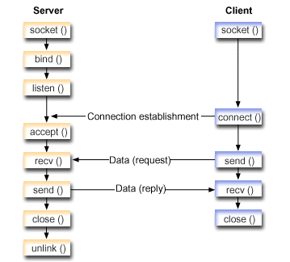
Socket Based Communication

Slide 55
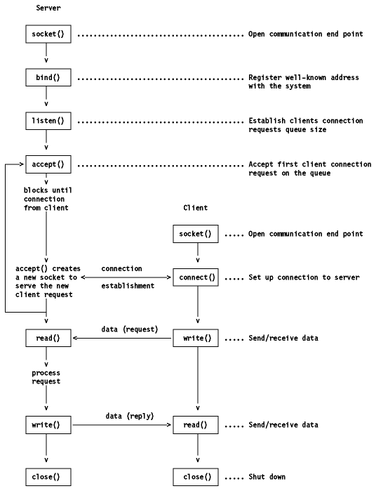
Socket Based Communication

Slide 56
Remote Procedure Calls
DCE Applications
DCE Middleware
Host Operating System and Networking
Remote Procedure Call (RPC) abstracts procedure calls between processes on networked systems. Provided by some Middleware e.g. Distributed Computing Environment (DCE)
Stubs – client-side proxy for the actual procedure on the server.
The client-side stub locates the server and marshals the parameters.
The server-side stub receives this message, unpacks the marshaled parameters, and performs the procedure on the server.

Slide 57
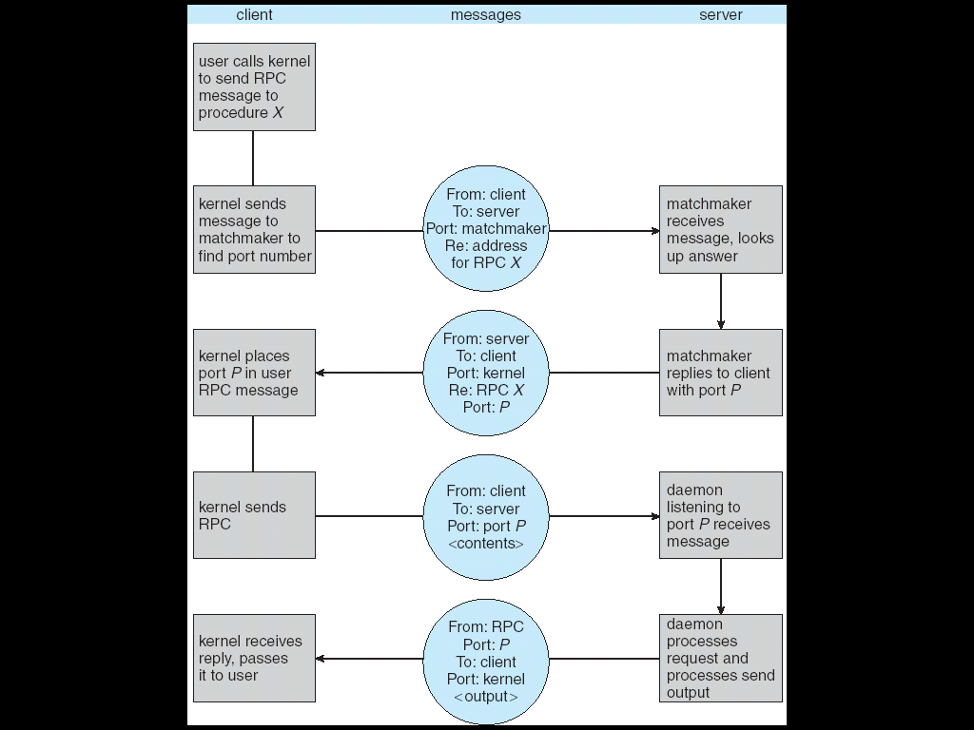
Execution of RPC

Slide 58

Remote Method Invocation
Remote Method Invocation (RMI) is a Java mechanism similar to RPCs.
RMI allows a Java program on one machine to invoke a method on a remote object.

Slide 59
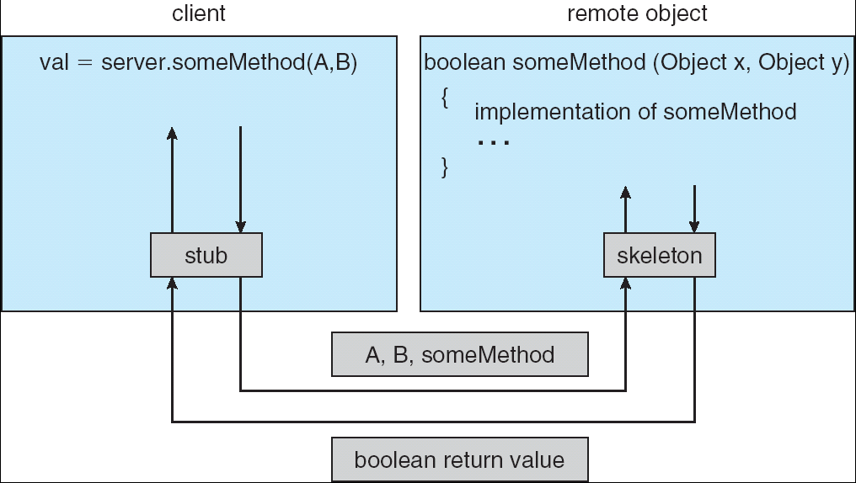
Marshalling Parameters

